Slide 1

Hum Air
By- team 6

Slide 2


BI Roles
Project Manager: Vraj
Data Analyst: Dhairya
Data scientist: Dhairya
Business analyst: Gurmeher
Solution Architect: Gurmeher
UI Designer: Avinash
ETL Developer: Pravina, Vraj
DevOps Engineer: Pravina
Data Visualization: Param, Vraj
QA Engineer: Param
Training Specialist: Avinash
Production Support Engineer: Pravina

Slide 3
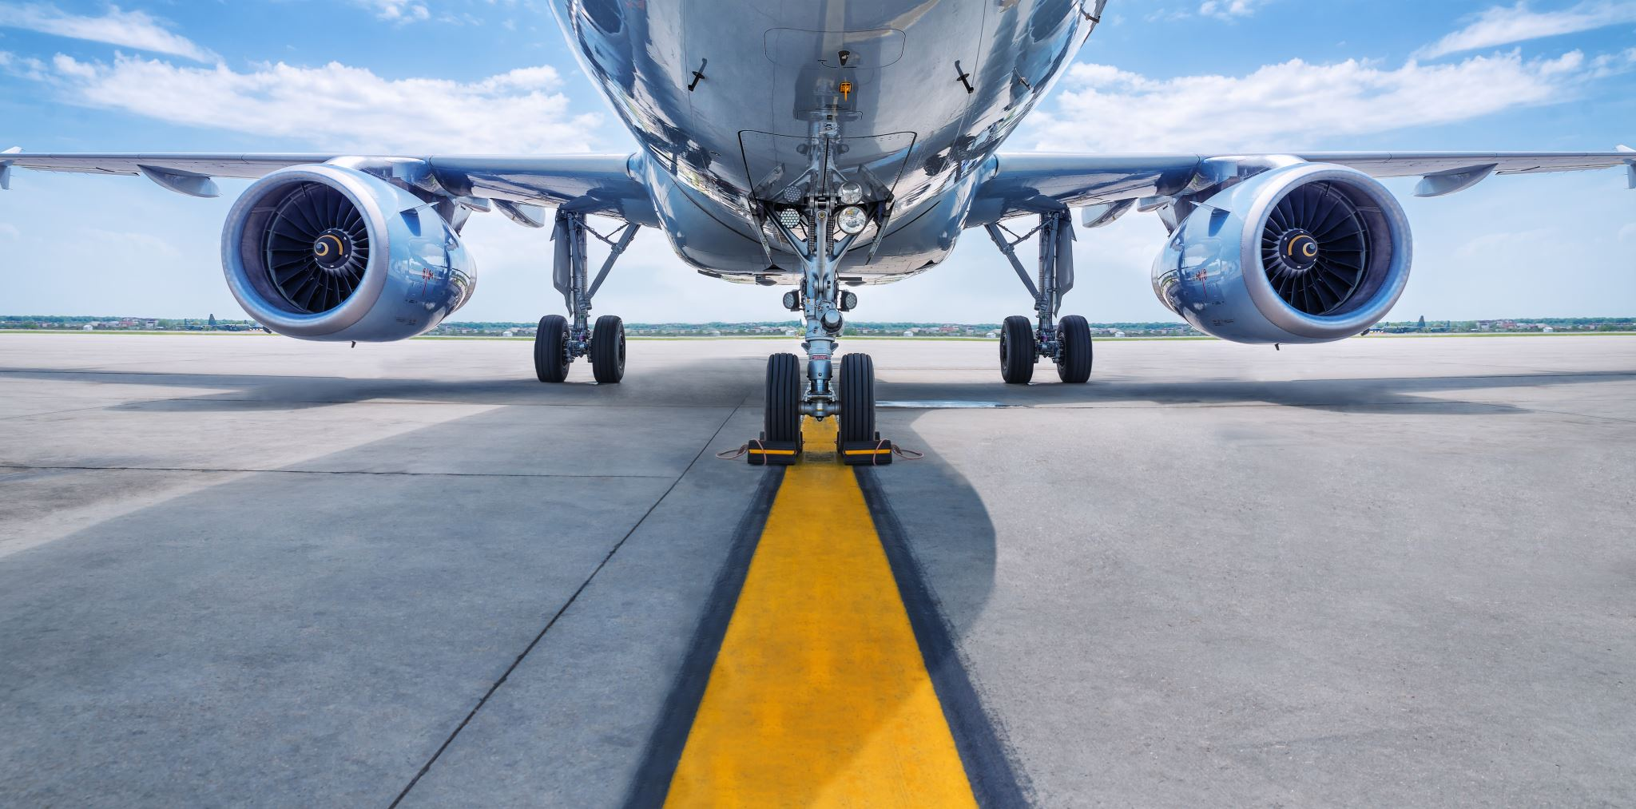
Company Description
Hum-Air" is an airline company that provides scheduled air transport for passengers to destinations inside Canada. Recently, Hum-Air is facing many baggage issues including lost, damaged, and delayed bags. Several passengers are criticizing Hum-Air online on different social media platforms about the airline's baggage problems, which is harming the airline's reputation. Hence, Hum-Air’s main focus is to reduce its baggage problems and retain customer loyalty to maintain its brand value.
Hum-Air provides its booking services via Hum-Air mobile application. This app can be downloaded by anyone who has a valid Canadian phone number.

Slide 4

Business problem
Reduction in customer loyalty because of baggage issues including delayed, damaged, and misplaced bags.

Slide 5

Analytical Questions
Descriptive:
What percentage of baggage is lost/delayed/damaged during transportation?
How many days does it take to resolve the baggage incident?
What is the average cost of compensating customers for lost/delayed/damaged baggage?
Which are the most vulnerable airports for baggage issues?
Are there any specific times of the year when baggage loss/delay/damage incidents increase?
What is the average processing time for each step during baggage processing?
What is the Growth/fall in incidents related to baggage issues in each category?
Diagnostic:
Which issue is stronger as compared to others and what was the reason?
Are there specific routes or airports where these incidents are more frequent and what was the reason?
Are there any common factors that contribute to baggage loss/delay/damage incidents?
What is the processing time for handling baggage at each stage of the journey?
Which part is taking longer time and the reason for the same?

Slide 6
Analytical Questions
Predictive:
What will be the likelihood of an increase in customer ratings if we provide them with real-time updates on their baggage location/status?
What will be the likelihood of a decreased percentage of baggage issues, if we use RFID or GPS for baggage tracking and monitoring?
What will be the likelihood of an increase in customer ratings if we provide good compensation value for baggage issues?
What will be the likelihood of a decrease in baggage issues if we use automated systems instead of the physical process?
Prescriptive:
What value of compensation should be decided so that customers remain loyal even after the baggage issue?
What will be the most effective communication strategies to inform customers about baggage loss/delay/damage incidents?
What technologies should be used to automate the baggage process so that baggage issues related to delay can be minimized?
What technologies (RFID, GPS, and AIRTAG) should be used which will be in our budget and effective to track the bags which are misplaced or lost?

Slide 7
Main Entities
User_Account
Passenger
Flight_Ticket
Baggage
Baggage_Process
Baggage_Incident
Compensation
Feedback

Slide 8

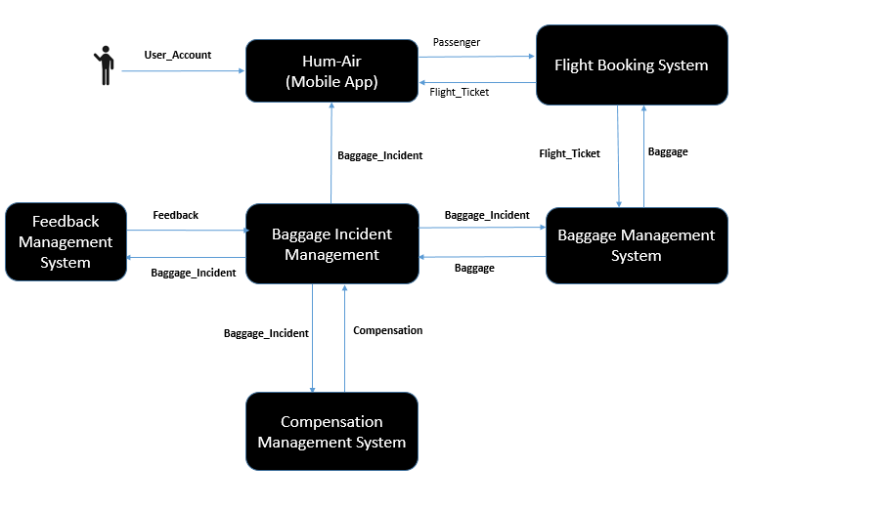
Context Model

Slide 9
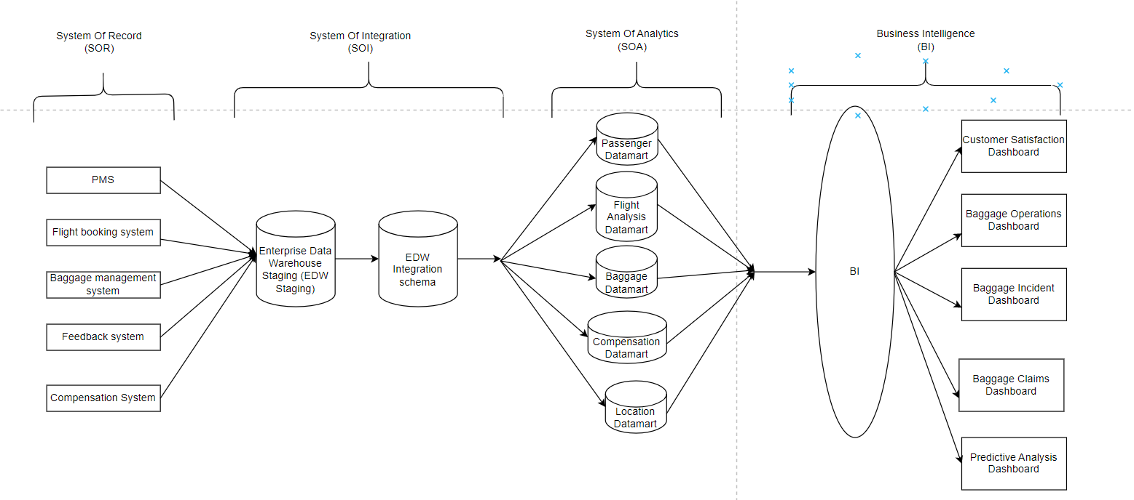
BI Hub-and-spoke Architecture diagram

Slide 10
BI and analytics solutions
Customer Satisfaction Dashboard
Baggage Operations Dashboard
Baggage Incident Dashboard
Baggage Claims Dashboard:

Slide 11

Important lesson learned
Managing conflicts in the team
Time management

Slide 12
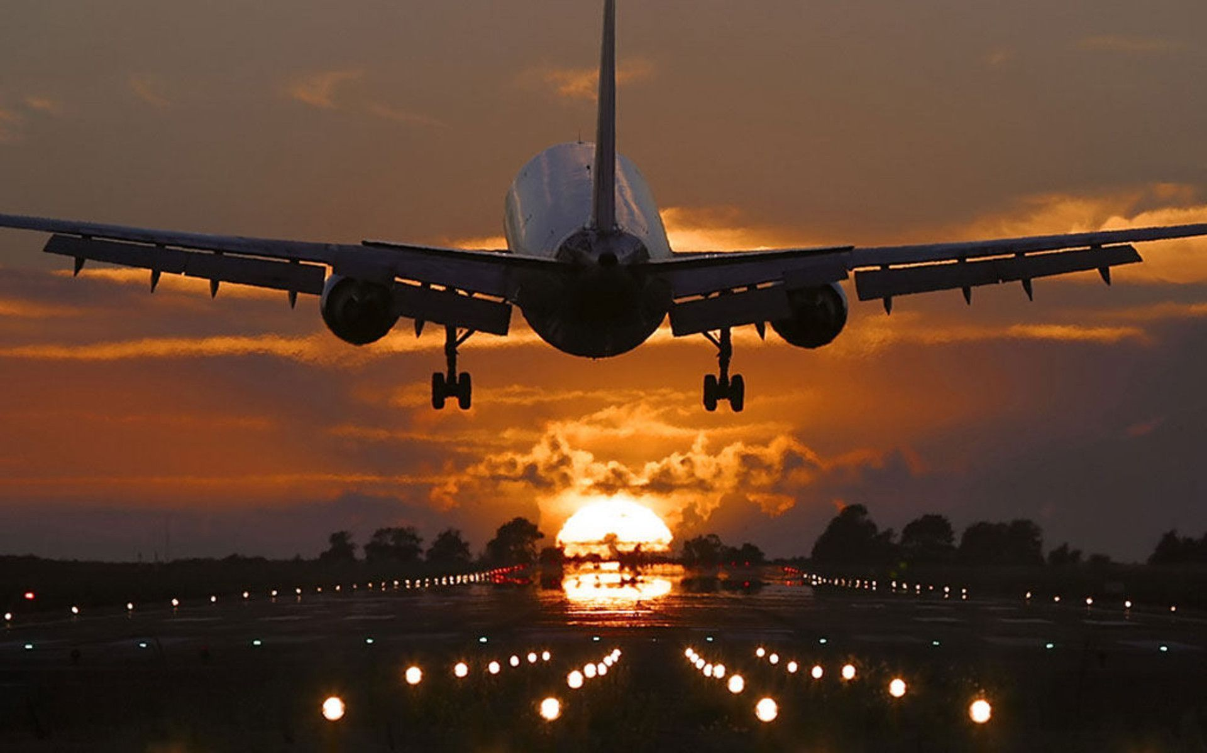
Thank you

